Slide 1
IN4601 Marketing I
Session 22 – Sales Promotions
Professor Ricardo Montoya

Slide 2
Marketing Planning Framework
Identify Market
Opportunities
CUSTOMER
COMPANY
COMPETITION
SEGMENTATION
TARGETING
POSITIONING
ACQUISITION-
RETENTION
Set Strategy
Formulate
Marketing
Program
PRODUCT
PRICE
PROMOTION
PLACE

Slide 3
Assessing Profit Impact of Promotions In-Class Exercise
The RM Candy Bar brand manager is considering options for promotions for the month of January 2014.
He has decided to freeze trade promotions so that all amounts will be identical by prior year’s month.
(i.e. Jan 2014 = Jan 2013, Feb 2014 = Feb 2013).
He is still considering whether to offer a consumer promotion during the month of January.
He wants to know:
What factors can he use to predict his sales?
How will the consumer promotion impact profits?
Should he go ahead with his promotion?

Slide 4
Assessing Profit Impact of Promotions In-Class Exercise
Candy Bars are sold to retailers in cases of 24. The regular gross margin the company makes on each bar is $2.20 per bar (i.e., $2.20 * 24 = $52.8 per case)
For simplicity, assume that the company offers only one bar size
The plan:
Distribute 2 million coupons, $1.00 face value, in each of the four Sundays in January
Each coupon is valid towards the purchase of one bar
On average 10% of the coupons are redeemed
Printing and distribution costs for the coupons are $20 per thousand coupons
Coupon processing costs are 10 cents per redeemed coupon
Notes:
Should the brand manager go ahead with the promotion? Show profit impact.

Slide 5
Assessing Profit Impact of Promotions In-Class Exercise
He has data from the last few years in which he has offered different consumer and trade promotions and seen various levels of sales
Note that the Consumer Promotion variable in the dataset represents the total dollar amount of redeemed coupons by consumers
The Trade Promotion variable represents dealer allowances that include co-op advertising, display allowances, slotting allowances, etc.

Slide 6
RM’s Historical Sales Data
Month | Sales in Cases | Consumer Promotion | Trade Promotion
Jan-10 | 425,075 | $361,214 | $457,732
Feb-10 | 315,305 | $72,173 | $254,396
Mar-10 | 367,286 | $645,312 | $259,952
Apr-10 | 429,432 | $574,752 | $267,368
May-10 | 347,874 | $650,832 | $158,504
Jun-10 | 435,529 | $910,267 | $430,012
Jul-10 | 299,403 | $44,678 | $388,516
Aug-10 | 296,505 | $197,275 | $225,616
Sep-10 | 426,701 | $45,077 | $1,042,304
Oct-10 | 329,722 | $4,522 | $974,092
Nov-10 | 281,783 | $8,726 | $301,892
Dec-10 | 166,391 | $3,226 | $76,148
Jan-11 | 629,402 | $2,633,779 | $0
Feb-11 | 263,467 | $253,526 | $315,196
Mar-11 | 389,320 | $13,406 | $703,624
Apr-11 | 376,569 | $133,195 | $198,464
May-11 | 444,404 | $105,058 | $478,880
Jun-11 | 386,986 | $5,328 | $457,172
Jul-11 | 414,314 | $2,093 | $709,480
Aug-11 | 253,493 | $6,754 | $45,380
Sep-11 | 484,365 | $1,807,920 | $28,080
Oct-11 | 305,989 | $589,949 | $111,520
Nov-11 | 315,407 | $72,662 | $267,200
Dec-11 | 182,784 | $26,554 | $354,304
Jan-12 | 655,748 | $2,615,074 | $664,712
Feb-12 | 270,483 | $209,798 | $536,824
Mar-12 | 365,058 | $27,552 | $551,560
Apr-12 | 313,135 | $46,147 | $150,080
May-12 | 528,210 | $7,234 | $580,800
Jun-12 | 379,856 | $65,376 | $435,080
Jul-12 | 472,058 | $485,659 | $361,144
Aug-12 | 254,516 | $385,483 | $97,844
Sep-12 | 551,354 | $1,611,686 | $30,372
Oct-12 | 335,826 | $440,208 | $150,324
Nov-12 | 320,408 | $47,309 | $293,044
Dec-12 | 276,901 | $514,426 | $162,788
Jan-13 | 455,136 | $1,438,949 | $32,532
Feb-13 | 247,570 | $101,846 | $23,468
Mar-13 | 622,204 | $754 | $4,503,456
Apr-13 | 429,331 | $62,213 | $500,904
May-13 | 453,156 | $1,600,939 | $0
Jun-13 | 320,103 | $854,904 | $0
Jul-13 | 451,779 | $1,514,707 | $46,104
Aug-13 | 249,482 | $384,989 | $92,252
Sep-13 | 744,583 | $28,512 | $4,869,952
Oct-13 | 421,186 | $176,731 | $376,556
Nov-13 | 397,367 | $1,125,898 | $376,556
Dec-13 | 269,096 | $345,029 | $552,536

Slide 7
A closer look…
Month | Sales in Cases | Consumer Promotion | Trade Promotion
Jan-10 | 425,075 | $361,214 | $457,732
Feb-10 | 315,305 | $72,173 | $254,396
Mar-10 | 367,286 | $645,312 | $259,952
Apr-10 | 429,432 | $574,752 | $267,368
May-10 | 347,874 | $650,832 | $158,504

Slide 8
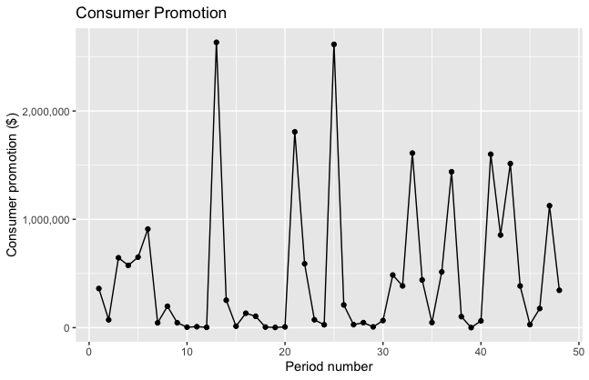
RM’s Consumer Promotion Over Time

Slide 9
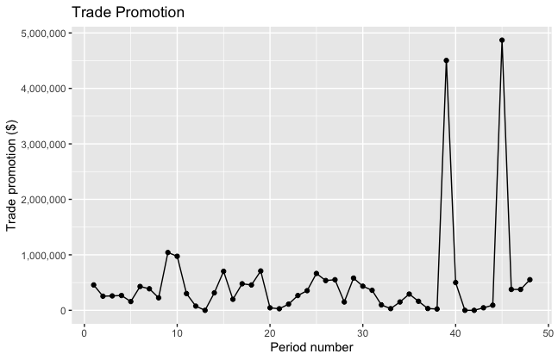
RM’s Trade Promotion Over Time

Slide 10
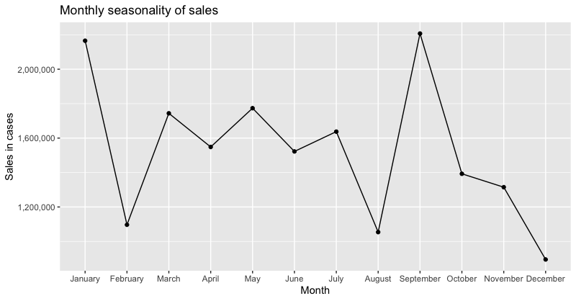
RM’s Sales over Time

Slide 11
RM’s Sales Seasonality

Slide 12
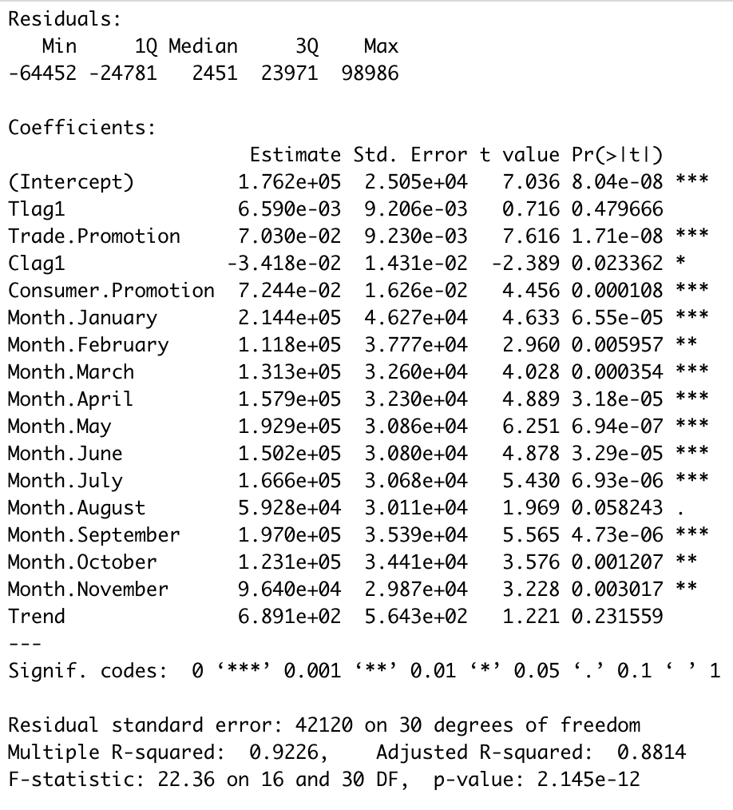
Prepare data frame to predict sales
No treatment of variables

Slide 13
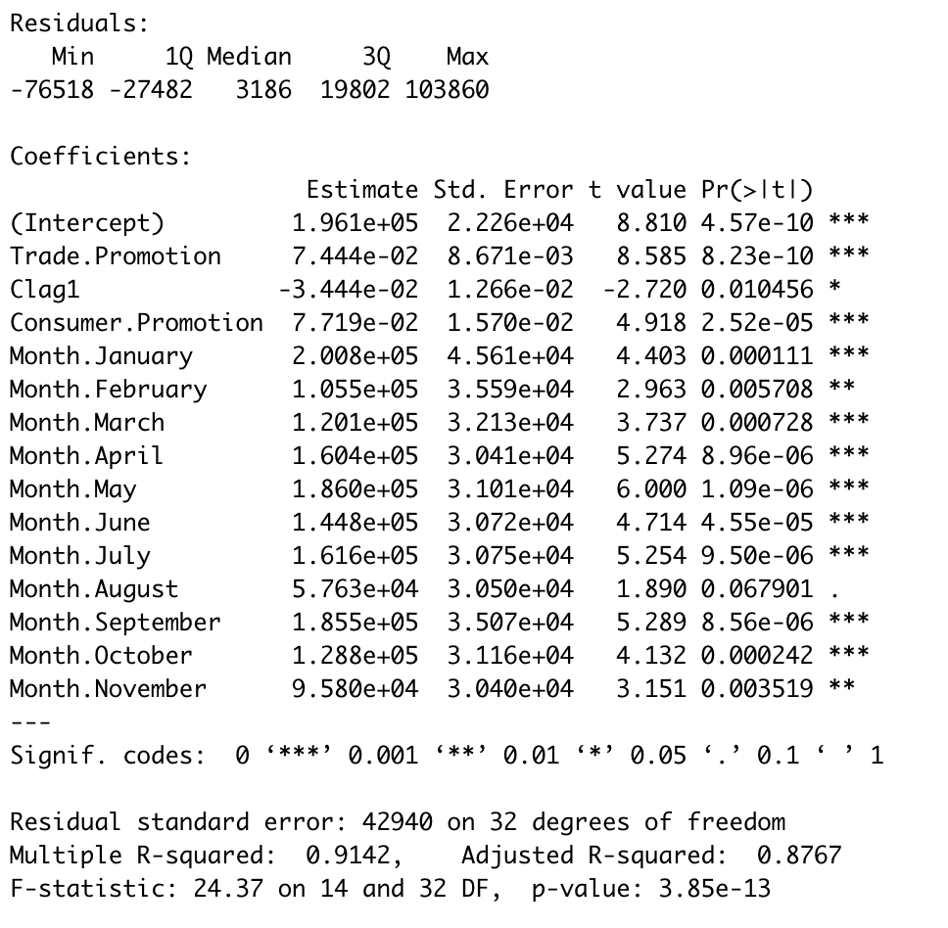
Prepare data frame to predict sales
Excluding no statistically significant variables

Slide 14
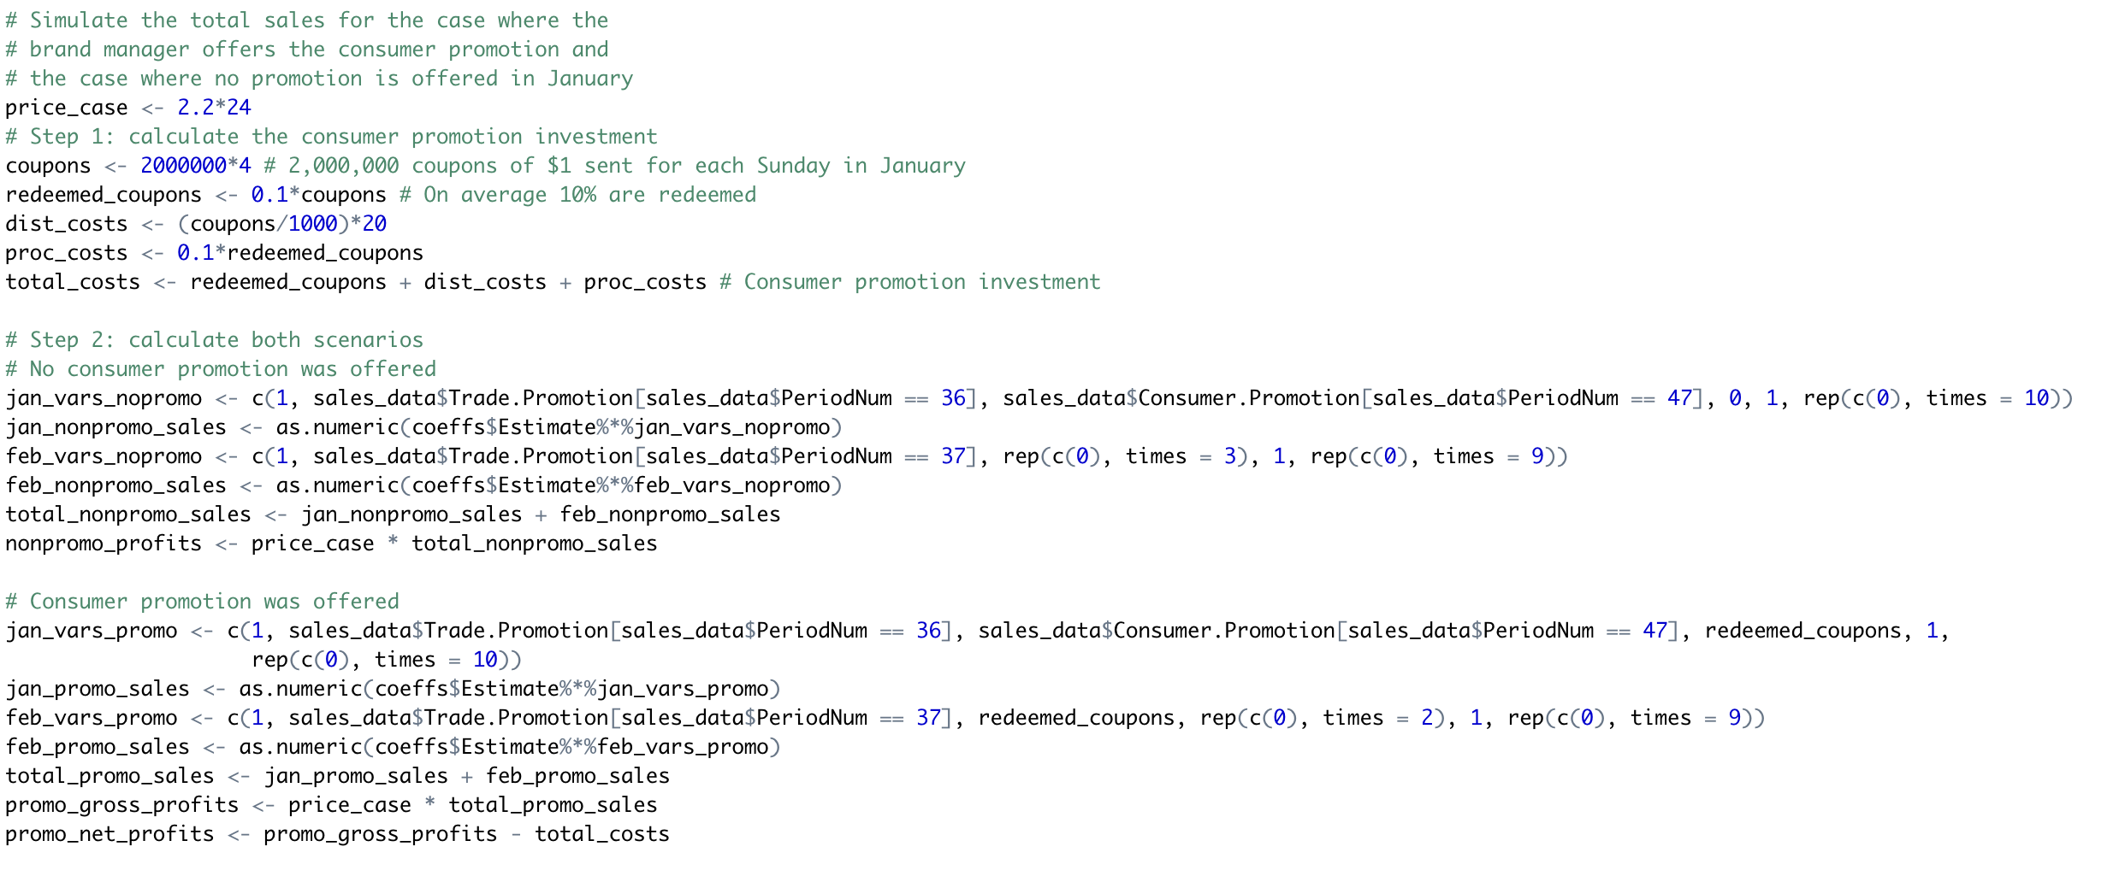
Should we offer promotion
Simulate the total sales if the brand manager offers consumer promotion in January vs not.

Slide 15
Should we offer promotion
Estimate “baseline” sales
Identify incremental sales due to promotion
Profitability = Profits from incremental sales - cost of Promotion
Net profit promo - Net profit non promo = 766110.6
Worth running promotion

Slide 16
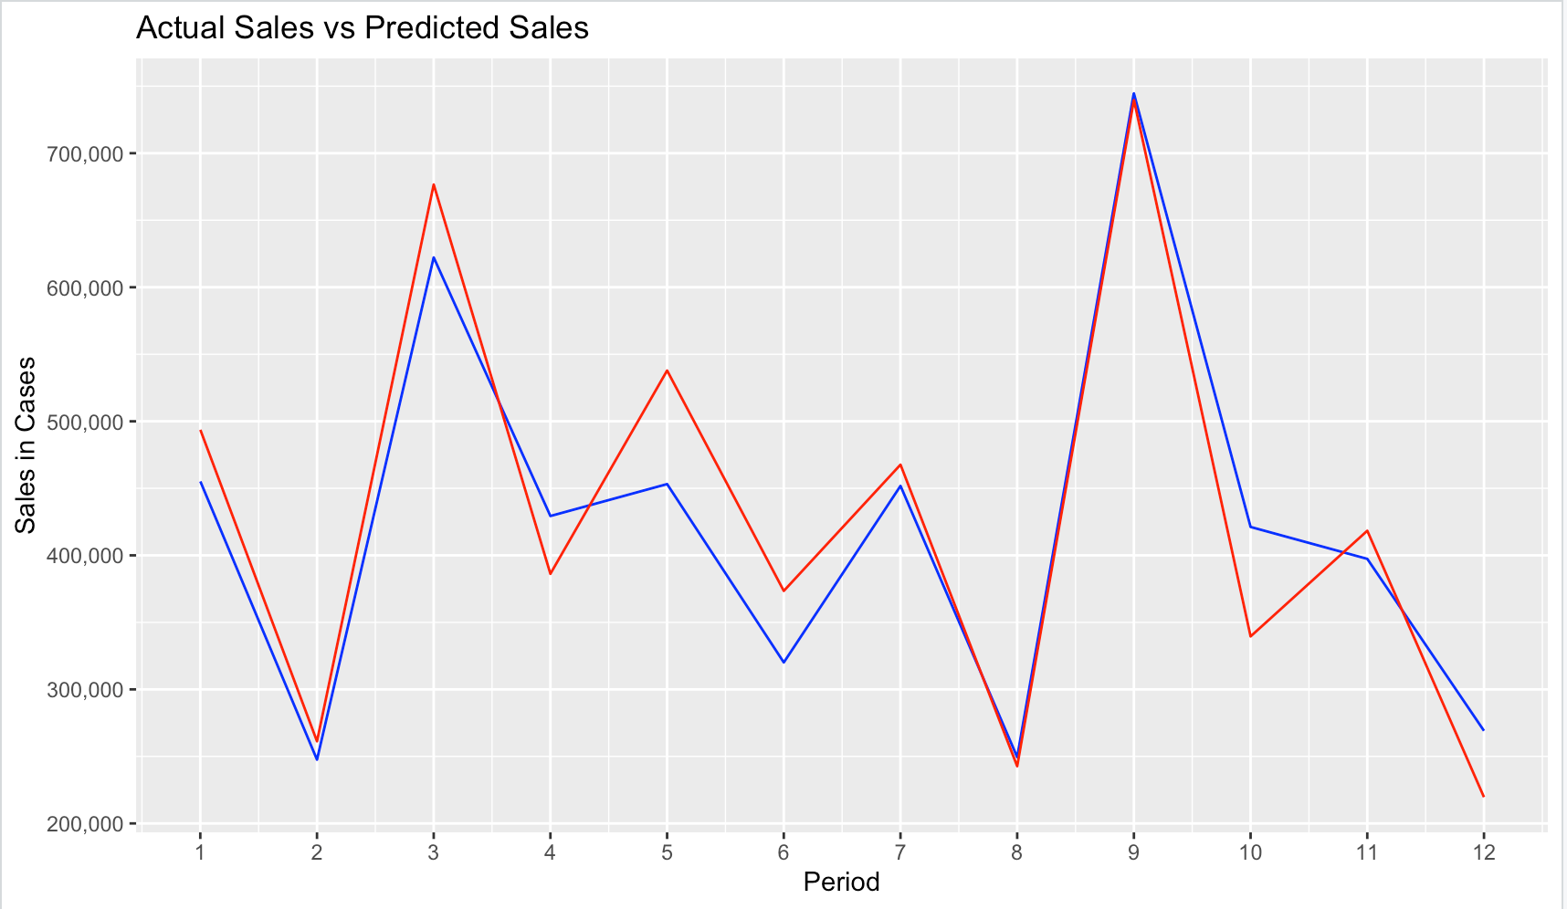
Predict sales & promotional effects
Training with the last 3 years of data want to predict last year's sales to compare it with what really occurred
Predicted sales
Real sales
We can see in the graph the drop in sales product by the promotional effect. In our example it translate in -27548.83 if we compare promotional effect in feb vs no promotional

Slide 17
Takeaways
Evaluating a price cut promotional program involves comparing estimates of sales and profit without the program (called baseline estimates) and comparing these estimates with those associated with running the promotional program.
Estimates should consider effects of promotions on the period in which they are offered as well as on subsequent and prior periods to account for potential stock-up, stockpiling, and other enduring effects of the promotion.
Regression analysis is a tool that can be applied to historical data to make sales estimates and forecasts.

Slide 18
Takeaways
A lag variable can be used to evaluate the effects of a promotion in a subsequent period. A lag variable is created by shifting all of the observations of a variable to correspond with the subsequent month.
Seasonality in a dependent variable can be accounted for with a set of indicator variables that represent the categories associated with the “seasons” (quarters, months, etc.)
A trend variable accounts for an increase or decrease in the dependent variable though time. A trend variable can be created with a increasing series associated with the passage of time.
Notes:
Recall the
Cost and benefit analysis for a promotion plan. In order to analyze this decision we have to estimate future sales. We learned how to use regression to estimate sales. Another lesson from this class is how to get more information from what appears to be at first a limited set of data.
When
Given a data set and your initial instinct will be to run immediately a regression. I recommend in general always to look at the data plot it and learn about the patterns that are visible to the eye. Had we not plotted the data we would not have noticed that there is seasonality in the data that there is a lag effect in the data.

Slide 19
Conclusions
Sales promotions are short terms instruments
Evaluation should look at profitability and competitive implications
Profitability depends upon incremental sales and costs of promotion

